Slide 1
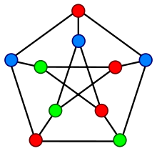
Sabancı University CS301 Algorithms
May 22, 2018
3-Colourability Problem
Emir Alaattin YILMAZ
Bora İKİZOĞLU
Selin SEZER
Can Berk GÜZGEREN
1

Slide 2
OUTLINE
Problem Description
Algorithm Desription
Algorithm Analysis
Experimental Analysis
Testing
Conclusion

Slide 3
Problem Description
Graph Colouring
A proper graph-colouring is the assignment of colors to the vertices of a graph and no adjacent vertices have the same color.
More formally,
An n-node undirected graph G(V,E) with node set V and edge set E, an assignment of a color ϕ_{v}, ϕ_{v} ≠ ϕ_{w} for every (v,w) ∈ E.

Slide 4
Problem Description
Graph Colouring
A graph colouring that properly uses k colors is called k-coloring.
The k-coloring decision problem asks, for each graph, G, is G k-colorable. Call this problem k-COLOR.
In this project, 3-COLOR will be examined, therefore our problem can be expressed as follows:
On an n-node undirected graph G(V,E) with node set V and edge set E, can each node of G(V,E) be assigned exactly one of three colors - Red, Blue, Green - in such a way that no two nodes which are joined by an edge, are assigned the same color?

Slide 5
Problem Description
Basic Definition of Problem
We want to colour vertices of a graph with exactly use of 3 colors and no adjacent vertices have the same color.

Slide 6
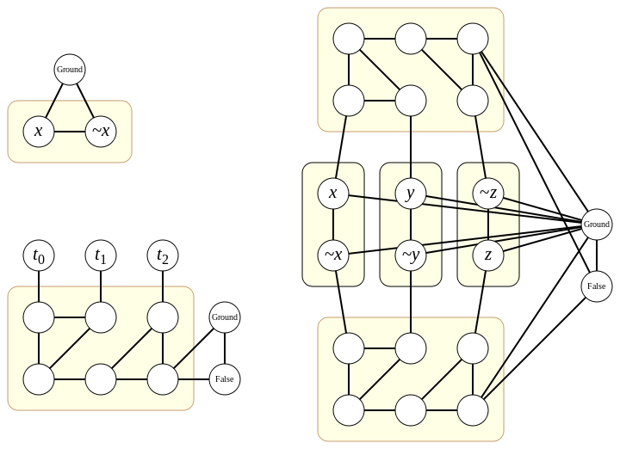
Problem Description
About Problem
3-COL is a NP-complete problem.
It is a reduction of 3-SAT.
NOTE: The figure on the left represents reduction of 3-COL from 3-SAT problem, our report detailly explained steps of that reduction on 3 pages. We will not cover that on this presentation.

Slide 7
Algorithm Description
Since, 3-COL is a NP-Complete problem, there is not an exact algorithm that solves 3-COL problem in polynomial time.
But there are some approximate algorithms such as greedy coloring and a more efficient one 3-coloring in time O(1.3446^{n}) by Richard Beigel and David Eppstein.
We will cover and analyze the performance of the greedy coloring algorithm for 3-COL problem.

Slide 8
Algorithm Description
Greedy-Coloring Algorithm
The algorithm basically does the following;
It colours the first vertex with the first color.
Then it checks the next vertex and color with the next color which is not used before on the vertices that adjacent to current vertex.
If all colors which are used before is seen on adjacent vertices of the current vertex, it creates a new color and assign it to that vertex.
Continue until there is no vertex that are not colored.

Slide 9
Algorithm Analysis
Greedy-Coloring Algorithm does not guarantee to find a solution with 3 colors, because if it can colour the graph with only use of 2 colors, it does not care about the condition it needs to have exactly 3 colors.
Also, if it gets stuck in 3-color, it just increases the number of colors to finish colouring all the vertices.

Slide 10
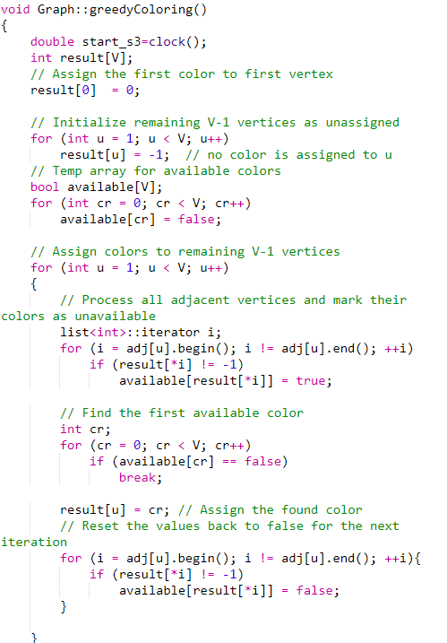
Algorithm Analysis
Running Time of Greedy-Coloring
O(V)
O(V)
O(V*V)
O(V)
O(V*V)
O(V*V)

Slide 11
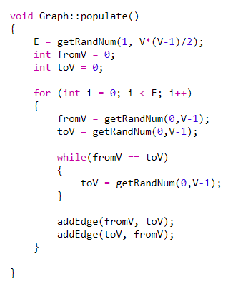
Algorithm Analysis
Running Time of Greedy-Coloring
O(E)
Running Time:
O(V) + O(V) + O(V²) + O(V²) + O(V²) + O(E) = O(V²+E)

Slide 12
Experimental Analysis
Success Rate
As mentioned before, if greedy algorithm uses more than 3 colors or just uses 2 colors, it is considered as a failure of that algorithm and we analyzed the success rate of our algorithm in this sense.
Number of Random Graphs | 5 Vertices | 6 Vertices | 7 Vertices | 8 Vertices | 9 Vertices | 10 Vertices | 15 Vertices | 20 Vertices
100 | 0.478 | 0.48 | 0.40 | 0.36 | 0.33 | 0.24 | 0.13 | 0.08
1000 | 0.481 | 0.483 | 0.43 | 0.349 | 0.298 | 0.237 | 0.144 | 0.087
3000 | 0.4773 | 0.4893 | 0.427 | 0.375 | 0.304 | 0.2596 | 0.137 | 0.0923
5000 | 0.4694 | 0.488 | 0.4308 | 0.3688 | 0.3148 | 0.253 | 0.127 | 0.0966
10000 | 0.473 | 0.4901 | 0.4321 | 0.3559 | 0.3007 | 0.2562 | 0.1398 | 0.0997
Fig.1 Success rates table of randomly generated graphs with different vertices

Slide 13
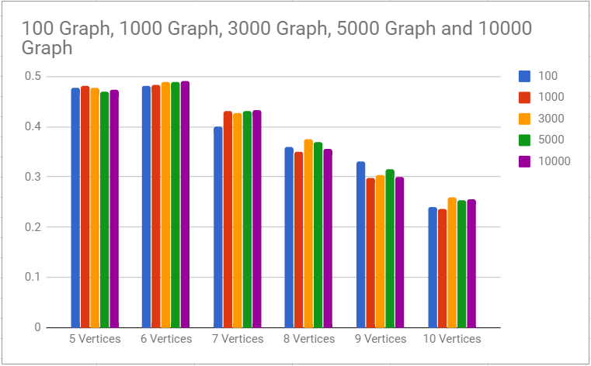
Success Rate
Experimental Analysis
Fig.2. Success rate graph of randomly generated graphs

Slide 14
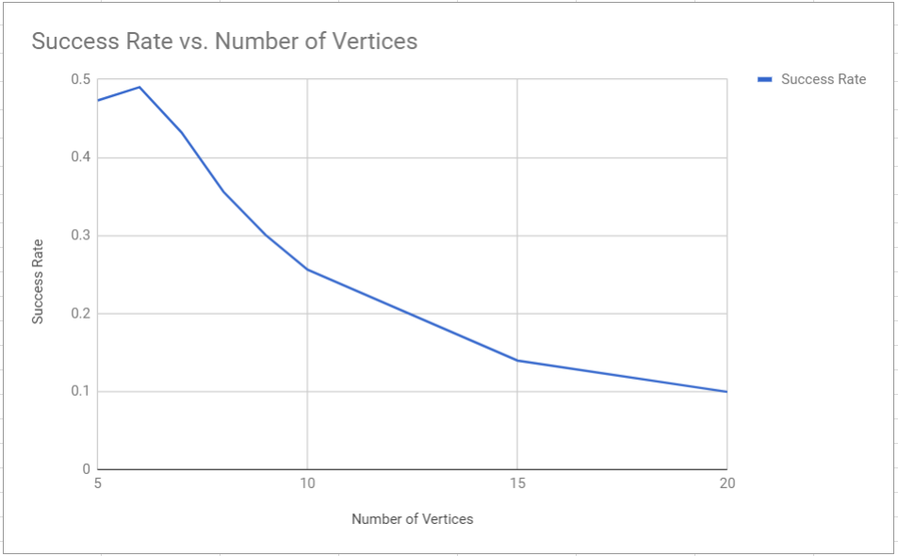
Success Rate
Experimental Analysis
It can be understood that while number of vertices are increasing, chance of finding solution to the 3-COL problem of our greedy algorithm is decreasing.
Number of Vertices | Success Rate
5 | 0.473
6 | 0.4901
7 | 0.4321
8 | 0.3559
9 | 0.3007
10 | 0.2562
15 | 0.1398
20 | 0.0997
That means it has a 47% chance to find a solution with 3 colors, for a graph with 5 vertices
If a graph has 20 vertices, this algorithm will find a 3 color solution with a chance of 9%
Fig.3. & Fig.4 Success rate table and graph according to number of vertices

Slide 15
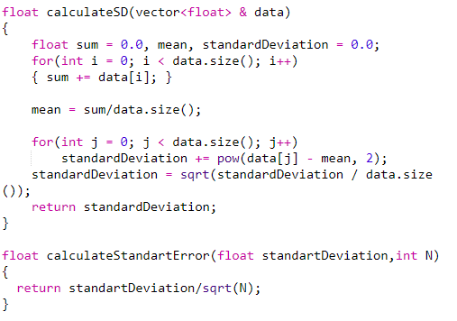
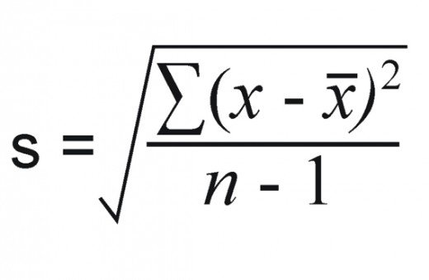

Experimental Measurement of Running Time
Experimental Analysis
In order to analyze running time of our algorithm experimentally, we created some functions to help us to interpret some statistic concepts as standard deviation, standard error, sample mean, confidence level intervals.
Standard Deviation
Standard Error (sm)

Slide 16
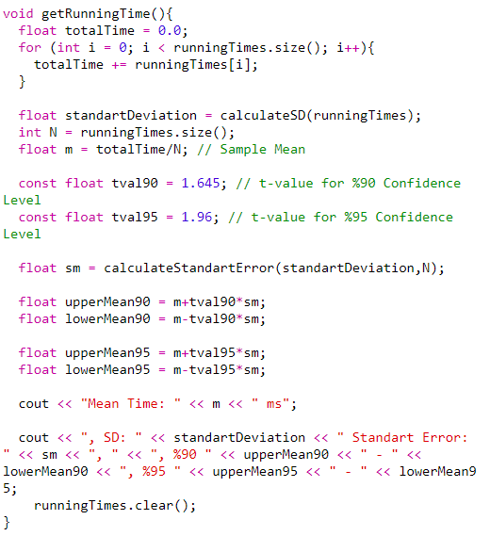
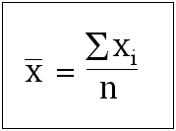
Experimental Measurement of Running Time
Experimental Analysis
As can be understand in the code on the left, this function is used for calculating the true mean in 90% and 95% confidence level intervals (t-values are used as fixed values for that confidence levels because after 100 samples they are so close to each other, and our samples are all higher than 100)
t-values for 90% and 95% Confidence Level
Confidence Interval
X̄ ± tval*sm

Slide 17
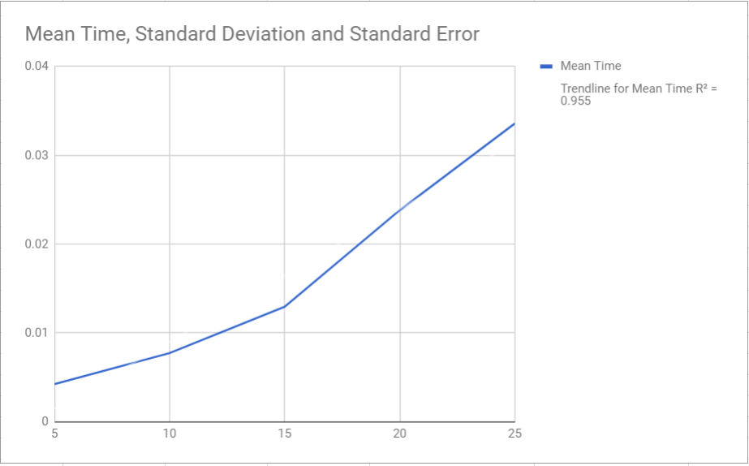
100 RUN PER INPUT SIZE
Experimental Analysis
Fig.8. Running time Graph of 100 run according to input size (number of vertices)
Size | Mean Time(s) | Standard Deviation | Standard Error | %90-CL | %95-CL
5 | 0.00424 | 0.00232861 | 0.000232861 | 0.00462305- 0.00385694 | 0.00469641- 0.00378359
10 | 0.00774 | 0.00437177 | 0.000437177 | 0.00845916- 0.00702085 | 0.00859687- 0.00688313
15 | 0.01295 | 0.00669533 | 0.000669533 | 0.0140514- 0.0118486 | 0.0142623- 0.0116377
20 | 0.02383 | 0.0165747 | 0.00165747 | 0.0265565- 0.0211035 | 0.0270786- 0.0205814
25 | 0.03359 | 0.0199445 | 0.00199445 | 0.0368709- 0.0303091 | 0.0374991- 0.0296809
Fig.7. 100 Run for 5,10,15,20,25 vertices and Mean times, Standart Deviation, Standart Error, Confidence Levels

Slide 18
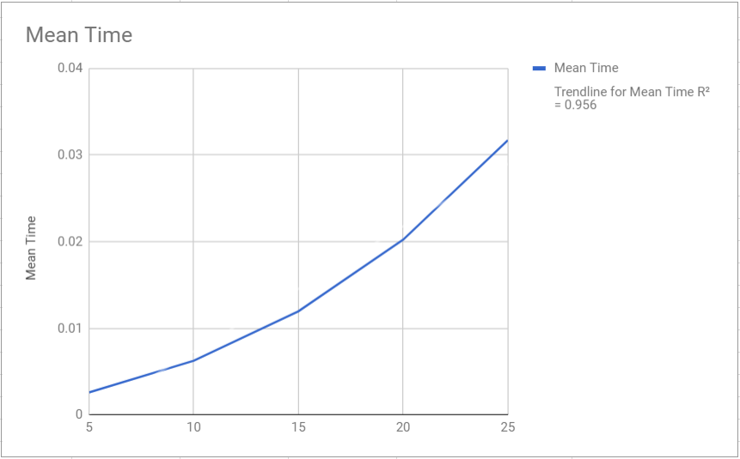
1000 RUN PER INPUT SIZE
Experimental Analysis
Fig.10. Running time Graph of 1000 run according to input size (number of vertices)
Size | Mean Time(s) | Standard Deviation | Standard Error | %90-CL | %95-CL
5 | 0.002614 | 0.00156812 | 4.96E-05 | 0.00269558- 0.00253243 | 0.0027112 - 0.00251681
10 | 0.00626399 | 0.00287234 | 9.08E-05 | 0.00641341- 0.00611458 | 0.00644202 - 0.00608597
15 | 0.011974 | 0.00590841 | 0.00018684 | 0.0122813- 0.0116666 | 0.0123402 – 0.0116078
20 | 0.02023 | 0.011063 | 0.000349844 | 0.0208055- 0.0196545 | 0.0209157 – 0.0195443
25 | 0.031714 | 0.0188678 | 0.000596651 | 0.0326955- 0.0307325 | 0.0328834 - 0.0305445
Fig.9. 1000 Run Table for 5,10,15,20,25 vertices and Mean times, Standart Deviation, Standart Error, Confidence Levels

Slide 19
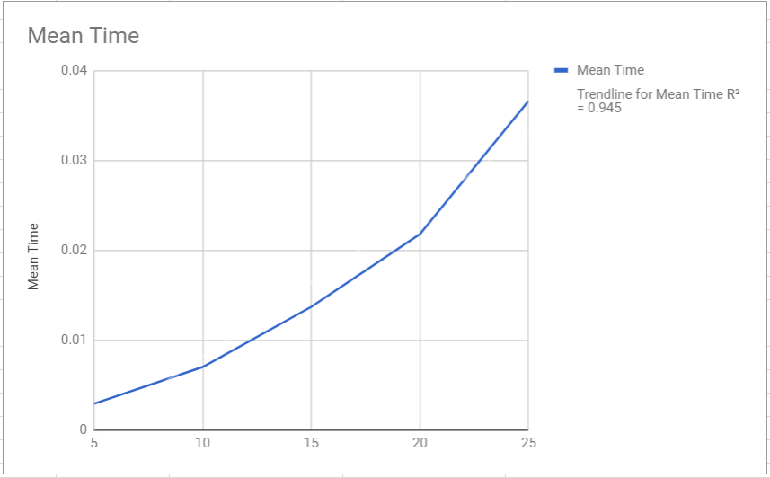
3000 RUN PER INPUT SIZE
Experimental Analysis
Fig.10. Running time Graph of 3000 run according to input size (number of vertices)
Size | Mean Time(s) | Standard Deviation | Standard Error | %90-CL | %95-CL
5 | 0.00288363 | 0.00166417 | 3.04E-05 | 0.00293361- 0.00283365 | 0.00294318- 0.00282408
10 | 0.00697033 | 0.00352543 | 6.44E-05 | 0.00707621- 0.00686445 | 0.00709648- 0.00684417
15 | 0.0136743 | 0.00820747 | 0.000149847 | 0.0139208- 0.0134278 | 0.013968- 0.0133806
20 | 0.02177 | 0.0137025 | 0.000250172 | 0.0221815- 0.0213584 | 0.0222603- 0.0212796
25 | 0.036593 | 0.0252588 | 0.00046116 | 0.0373516- 0.0358344 | 0.0374969- 0.0356891
Fig.11. 3000 Run Table for 5,10,15,20,25 vertices and Mean times, Standart Deviation, Standart Error, Confidence Levels

Slide 20
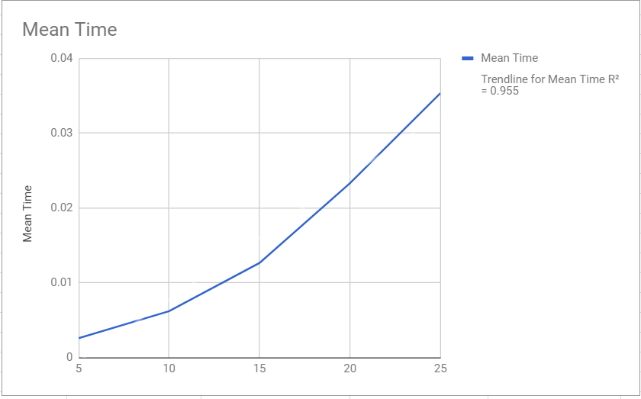
5000 RUN PER INPUT SIZE
Experimental Analysis
Fig.13. Running time Graph of 5000 run according to input size (number of vertices)
Size | Mean Time(s) | Standard Deviation | Standard Error | %90-CL | %95-CL
5 | 0.00261599 | 0.00133301 | 1.89E-05 | 0.002647 - 0.00258498 | 0.00265294 - 0.00257904
10 | 0.00621641 | 0.00265368 | 3.75E-05 | 0.00627814 - 0.00615467 | 0.00628996 - 0.00614285
15 | 0.0126694 | 0.00687041 | 9.72E-05 | 0.0128292 - 0.0125095 | 0.0128598 - 0.0124789
20 | 0.0233198 | 0.0145339 | 0.000205541 | 0.0236579 - 0.0229817 | 0.0237227 - 0.022917
25 | 0.0353543 | 0.0237548 | 0.000335944 | 0.0359069 - 0.0348016 | 0.0360127 - 0.0346958
Fig.12. 3000 Run Table for 5,10,15,20,25 vertices and Mean times, Standart Deviation, Standart Error, Confidence Levels

Slide 21
Testing
For testing our algorithm with different inputs we used black-box testing technique.
We randomly generated graphs for different number of vertices by a Graph class member function called populate() as can be seen below:

Slide 22
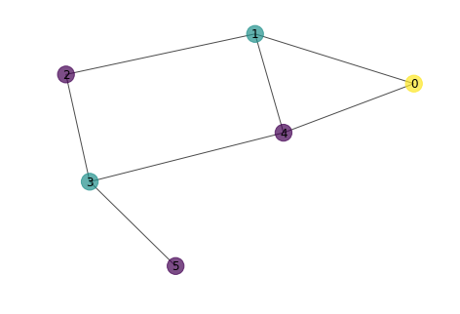
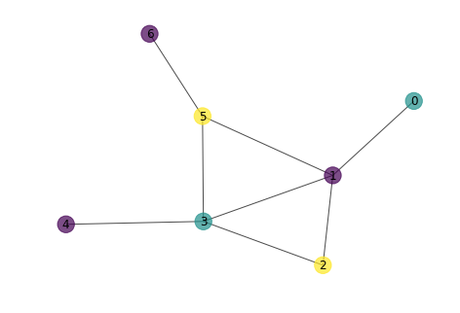
Some Test Result Graphs
Testing
Fig.14. Graph with Vertices: {0,1,2,3,4,5} Edges: (0,1),(0,4),(1,4),(1,2),(2,3),(3,4),(3,5)
Fig.15. Graph with Vertices: {0,1,2,3,4,5,6} Edges: (0,1),(1,2),(1,3),(1,5),(2,3),(3,5),(3,4),(5,6)

Slide 23
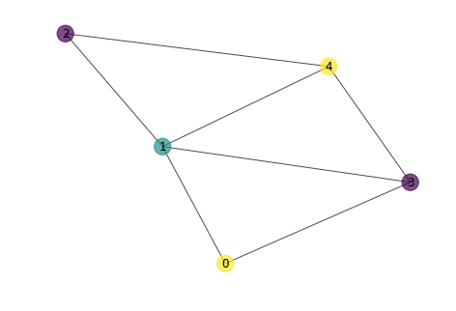
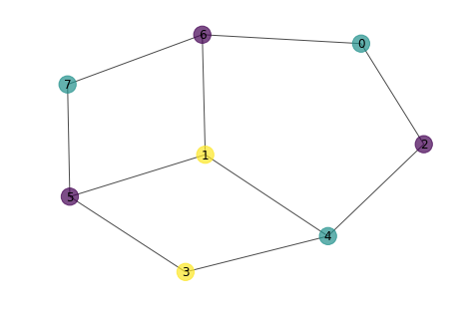
Some Test Result Graphs
Testing
Fig.16. Graph with Vertices: {0,1,2,3,4,5} Edges: (0,3),(0,1),(1,3),(1,2),(1,4),(3,4),(2,4)
Fig.17. Graph with Vertices: {0,1,2,3,4,5,6,7} Edges: (0,6),(0,2),(6,1),(2,4),(4,1),(4,3),(3,5),(1,5), (5,7), (6,7)

Slide 24
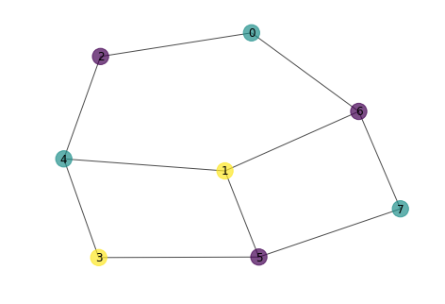
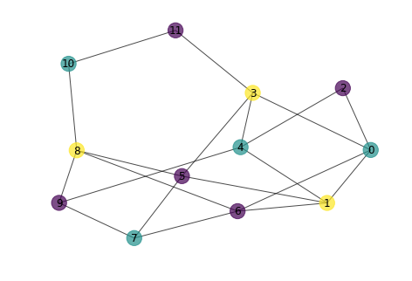
Some Test Result Graphs
Testing
Fig.18. Graph with Vertices: {0,1,2,3,4,5,6,7} Edges: (0,6),(0,2),(6,1),(2,4),(4,1),(4,3),(3,5),(1,5), (5,7), (6,7)
Fig.19. Graph with Vertices: {0,1,2,3,4,5,6,7} Edges: (0,1),(0,3),(3,4),(3,11),(10,8),(9,4),(11,10),(7,9), (1,5),(6,7),(5,8),(6,8),(9,8),(3,5)

Slide 25
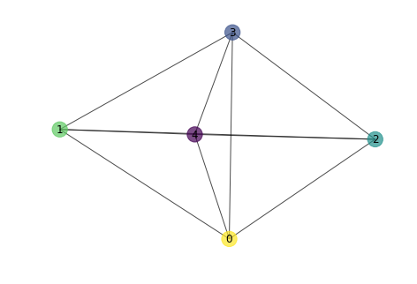
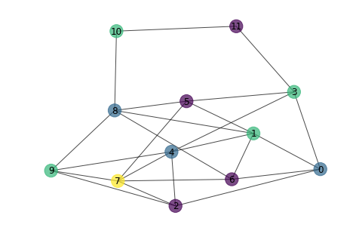
Some Test Result Graphs
Testing
FAILED
FAILED
Fig.20. Graph with Vertices: {0,1,2,3,4} Edges: (0,1),(0,2),(0,3),(0,4),(1,2),(1,3),(1,4),(2,3), (2,4), (3,4)
Fig.21. Graph with Vertices: {0,1,2,3,4,5,6,7,8,9,10,11} Edges: (0,1),(0,3),(3,4),(3,11),(2,9),(2,7),(4,7),(4,3),(8,1),(10,8),(9,4), (11,10),(7,9),(1,5),(6,7),(5,8),(6,8),(9,8),(3,5)

Slide 26
CONCLUSION
To sum up, 3-COLOR problem is a NP-Complete problem that is reduced from 3-SAT.
There is not such an exact efficient algorithm that solves that problem. There are just some approximate algorithms such as greedy-coloring.
Greedy-coloring algorithm does not always find the 3-color solution.
Chance of finding a 3-COLOR solution is decreasing inversely proportional to vertex number of graph (it decreases to 43%, 35%, 30% and goes on)
Running time measurement part shows a consistent trend (a quadratic type) with our result obtained from running time calculation in algorithm analysis part.

